Slide 1

ONE-WEEK HANDS-ON INTRODUCTION TO PYTHON AND MACHINE LEARNING (Python & ML Basics)
AI+ INVASION
AKURE
BY
GRACE UFEOSHI
March 25th – 29th, 2019

Slide 2
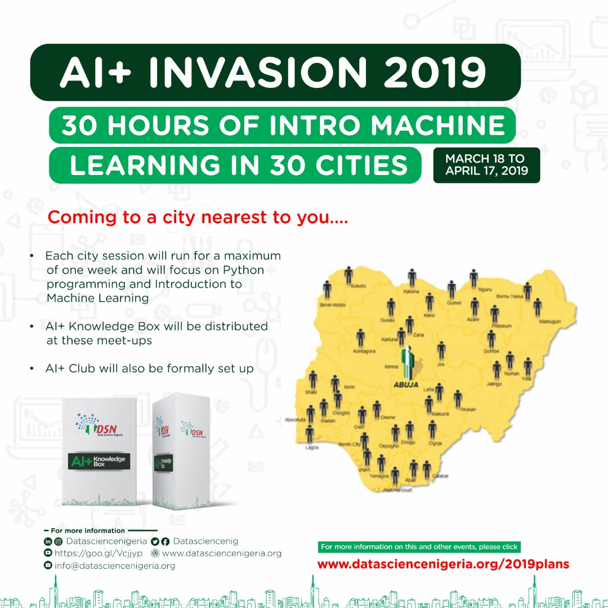

Slide 3

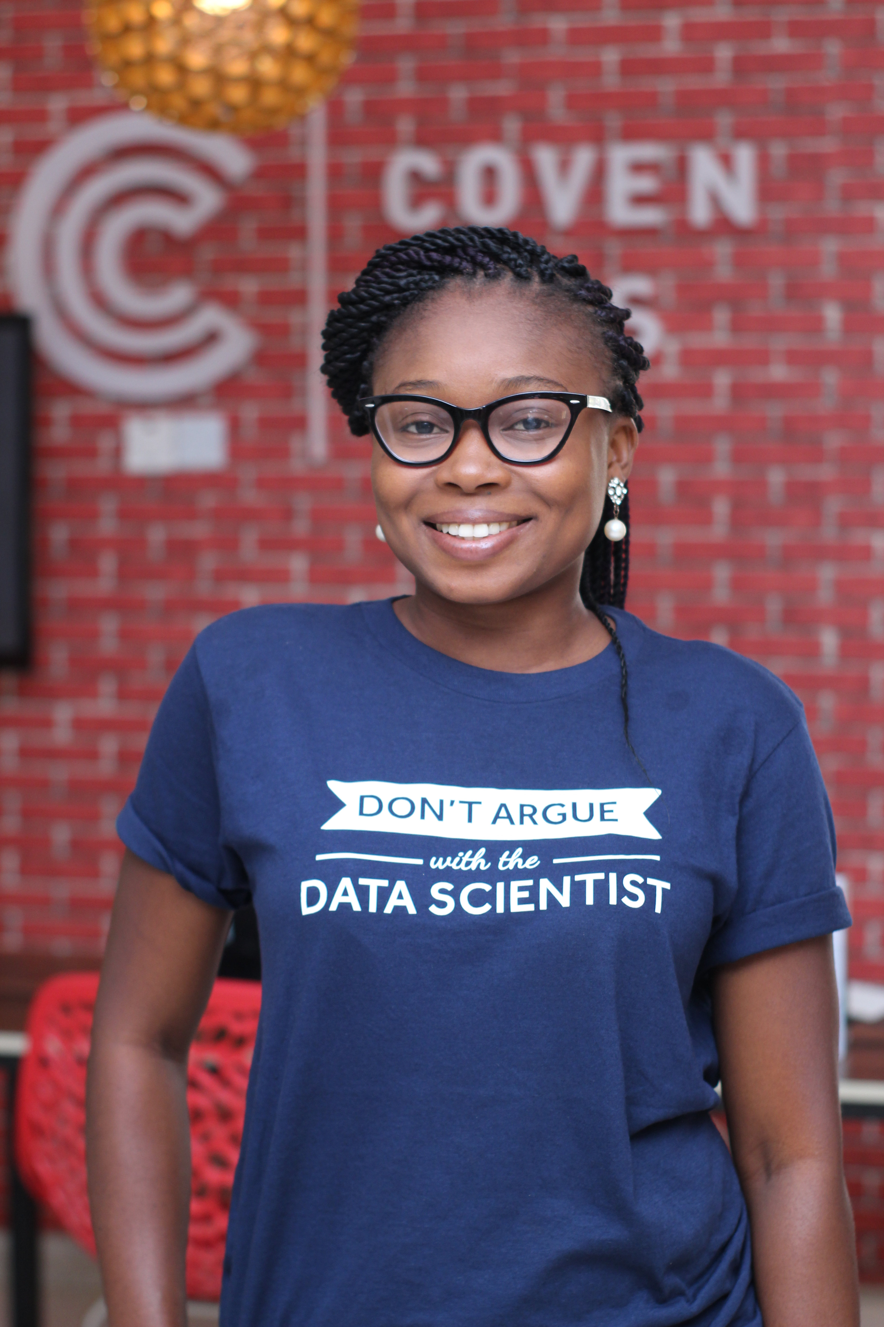




Meet Me
I am Grace IbukunOluwa Ufeoshi
I am an Artificial Intelligence Enthusiast and I love imparting knowledge!
You can find me at :
linkedin.com/in/ibukunfadahunsi
ibukunfadahunsi@gmail.com
@Gracefulibk
@gracefulibk

Slide 4

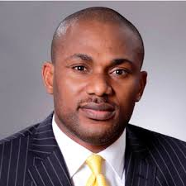
ABOUT DATA SCIENCE NIGERIA (DSN)
Data Science Nigeria is a non-profit driven by a vision to build a world-class Artificial Intelligence knowledge, research and innovation ecosystem that delivers high impact research, business use applications, locally-relevant AI-first start-ups, increase employability and drive for social good use cases.
DR BAYO ADEKANMBI
FOUNDER, DSN and CTO MTN NIGERIA

Slide 5

SOME SUCCESS STORIES
300,000+ direct download of our Artificial Intelligence for Starter free ebook with contribution from recognized leaders like Prof Yoshua Bengio .
10,212 participated in the 1st ever Intercampus Machine Learning competition that involved 95 universities.
12,234 online participants in Data Science course
Over 1,000 have participated in our face to face classes via fully residential all-expense-paid bootcamp, free meet-ups and weekly classes at the AI Hub.
203 direct job placement, project participation and internship.
4 innovative product ideas that are being pre-incubated
The largest convergence of academia and industry practitioners as mentors to support real-world application of learning.
High impact learning bootcamps, academic engagement and direct job placements (full time, freelance and internships) for young Nigerian data scientists
Strategic partnership with leading firms and organisation. e.t.c

Slide 6



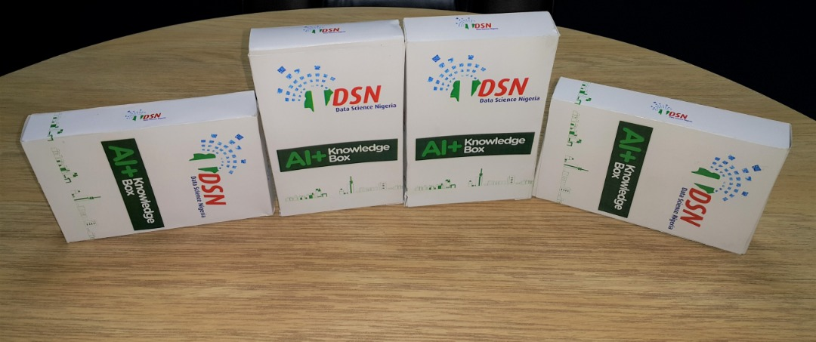
DSN AI⁺ COMMUNITY PERKS
Access to a pool of AI experts and mentors
Collaboration during AI⁺ Meetups and community events
Free access to 10,000⁺ AI videos from Novice – Advanced tracks

Slide 7
5-DAY TRAINING CONTENT
Introduction to Machine Learning- Python Basics and Jupyter Notebook Installations /Setup
Introduction to Machine Learning- Maths and Statistics
Supervised Learning – Regression Algorithms
Supervised Learning – Classification Algorithms
Unsupervised Learning – Clustering Algorithms

Slide 8
1. Basic Introductions
Introduction to Machine Learning

Slide 9
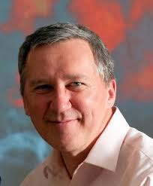
What is Machine Learning?
“A computer program is said to learn from experience E with respect to some class of tasks T and performance measure P if its performance at tasks in T, as measured by P, improves with experience E.” …. Tom Mitchell
Basically, Machine Learning is a branch of Artificial Intelligence (AI), which helps making machines capable of learning from observational data without being explicitly programmed.

Slide 10
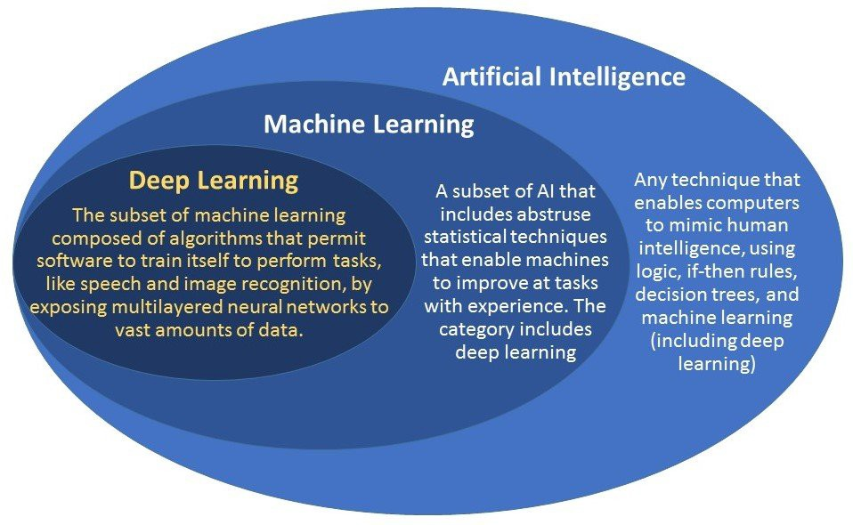
See the Differences (AI, ML, DL)
Photo Credit: Research Gate

Slide 11
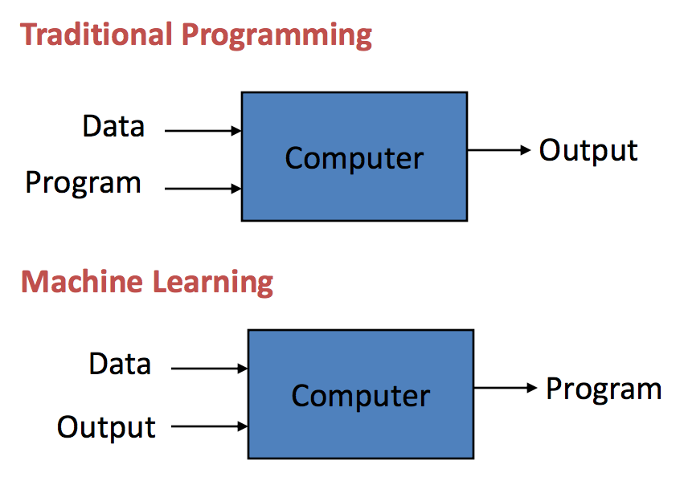
But why do we need ML or AI since programming exists?
Machine learning is getting computers to program themselves. If programming is automation, then machine learning is automating the process of automation.
--- Jason Brownlee (Machine Learning Mastery)

Slide 12
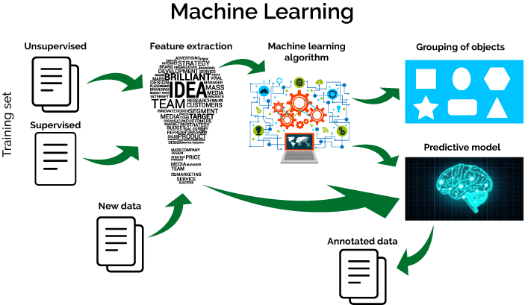
But why do we need ML or AI?
Machine Learning and Artificial Intelligence (AI) are based on automated and self-training algorithm to learn from prior data in order to find the pattern, which exists within, and then help machines to make decisions in situations they have never seen.

Slide 13

ML’s Expansion to Various Domains

Slide 14

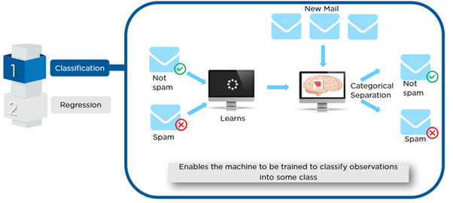
Machine Learning Use Case- Spam Detection
When Google Mail detects your spam mail automatically, it is as a result of applying machine learning techniques.

Slide 15
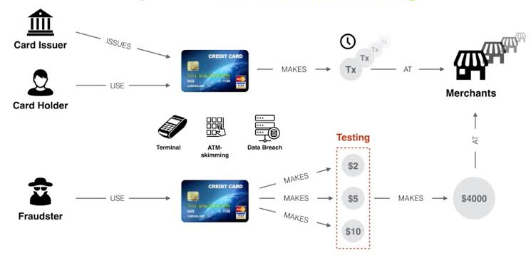
Machine Learning Use Case- Credit Card Fraud
Identifying 'unusual' activities on a credit card is often a machine-learning problem involving anomaly detection.

Slide 16

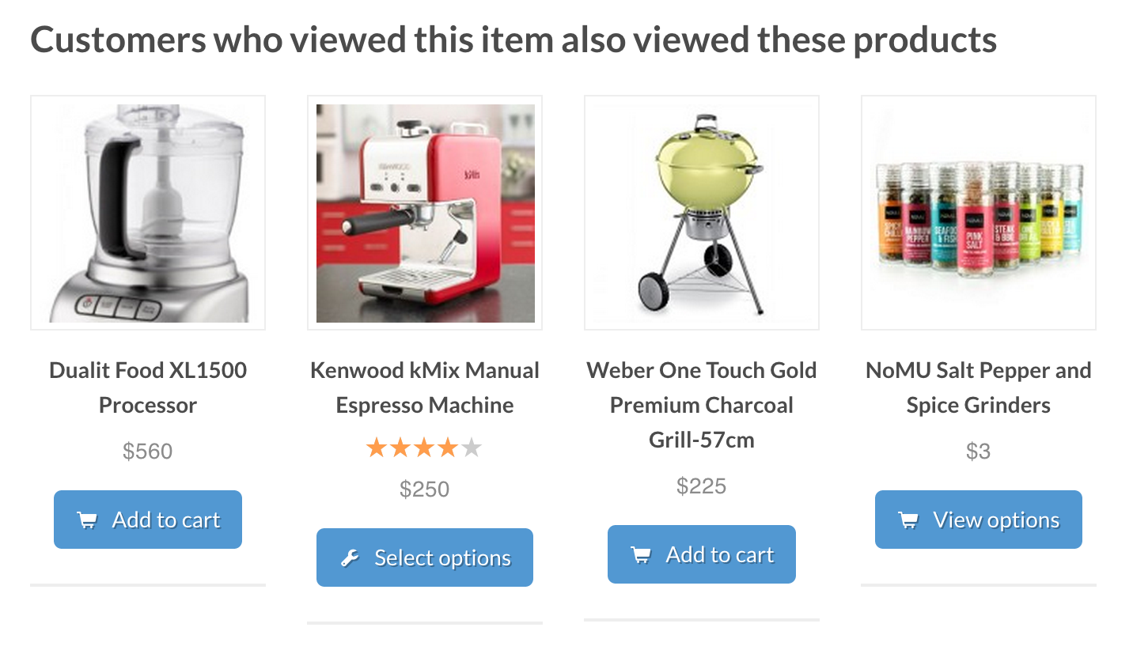
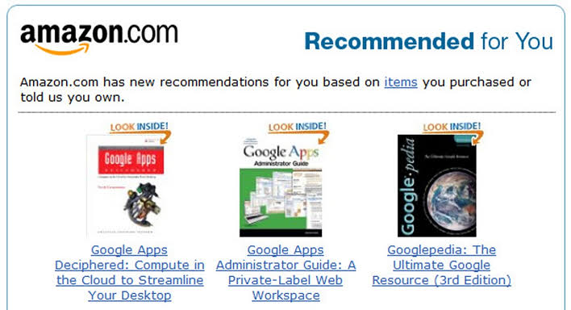
Product Recommendation
Whether Netflix was suggesting you watch House of Cards or Amazon was insisting you finally buy those Bose headphones, it's not magic, but machine learning at work!

Slide 17

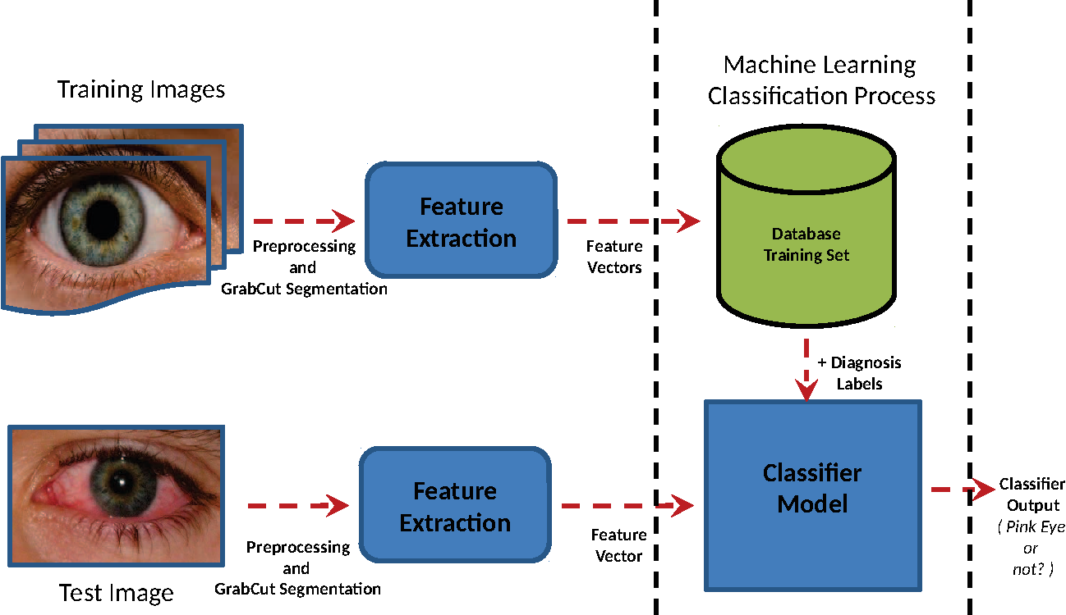
Medical Diagnosis
Using a database of symptoms and treatments of patients, a popular machine learning problem is to predict if a patient has a particular illness.

Slide 18
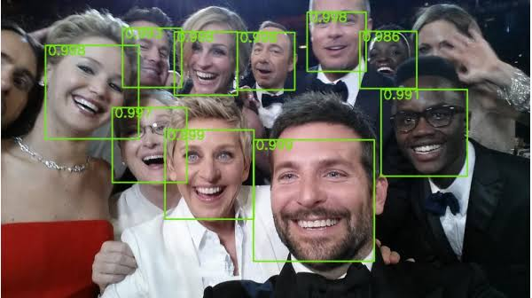
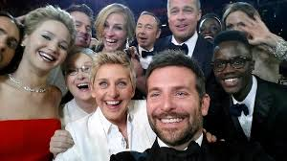
Face Detection
BEFORE
AFTER
When Facebook automatically recognizes faces of your friends in a photo, a machine learning process is what's running in the background.

Slide 19
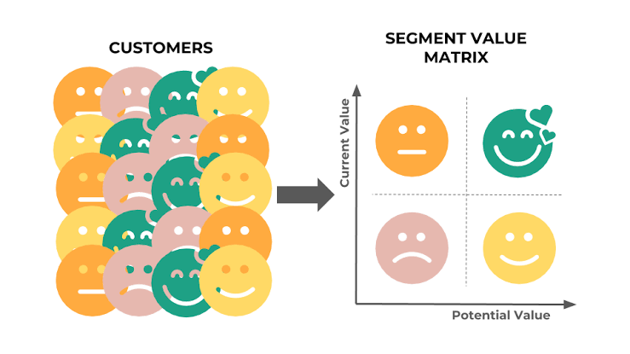
Customer Segmentation
Using the data for usage during a trial period of a product, identifying the users who will go onto subscribe for the paid version is a learning problem.

Slide 20
Data Analytics Pipeline

Slide 21
Type of Machine Learning Algorithms
Supervised Learning
Unsupervised Learning
Reinforcement Learning

Slide 22
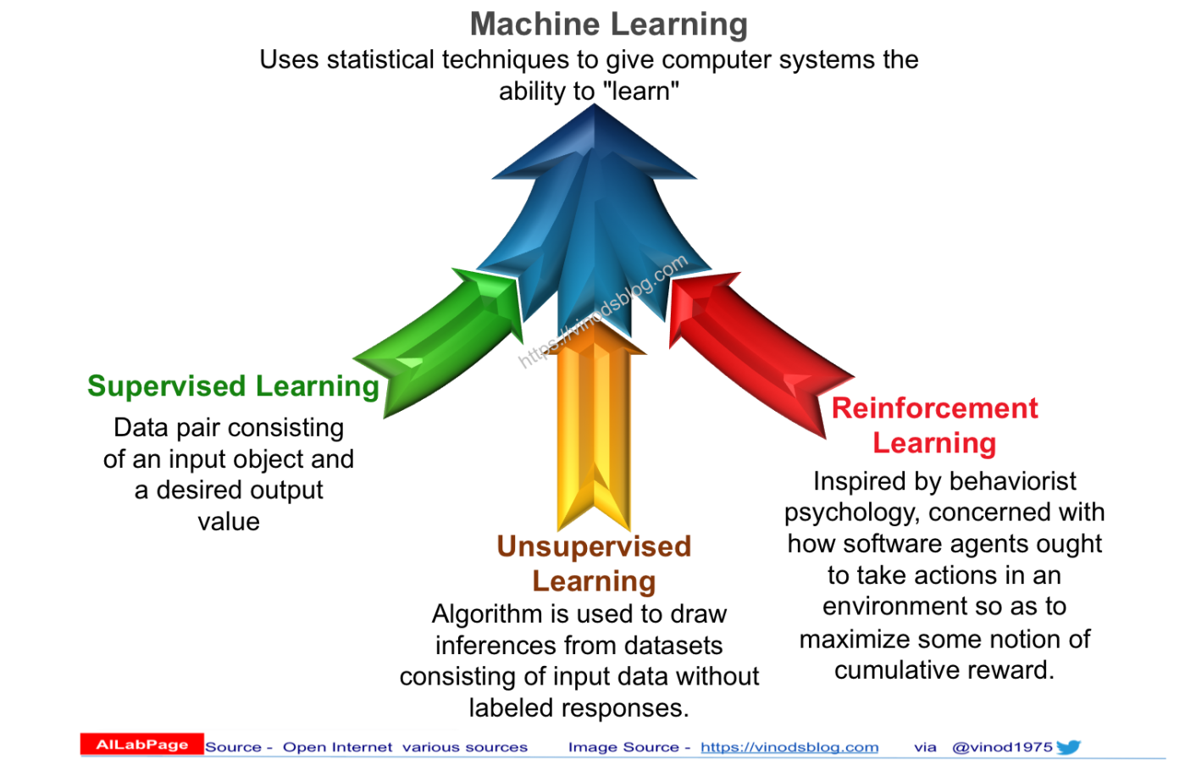

Slide 23

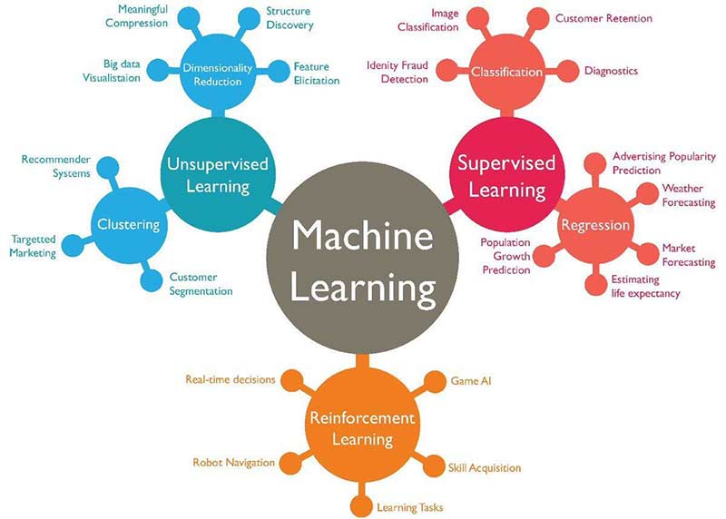

Slide 24
Types of Data Analytics

Slide 25

End of Introduction to Machine Learning

Slide 26

Jupyter notebook Installations
To install Jupyter Notebook, download Anaconda, the one which matches your OS requirements (Win/Mac/Linux).
Jupyter notebooks a have lot of advantages which are the following:
1) High-Performance Distribution: Easily install 1,000+ data science packages.
2) Package Management: Manage packages, dependencies and environments with Conda.
3) Portal to Data Science: Uncover insights in your data and create interactive visualizations.
4) Interactive: Coding and Visualization

Slide 27
Let’s head to the labs for hands-on practice of Python basics

Slide 28
THANK YOU!
Any questions?

